Slide 1
The Battle of Neighbourhoods - Franchise gym location in New York
Khadija EL GHAZI
Applied Data Science Capstone

Slide 2

Introduction:
New York City was home to nearly 8.4 million people in 2018, accounting for over 40% of the population of New York State. Due to New York growing in population each year with a finite amount of space, the state of New York is offering incentives to small fitness owners to open gyms/fitness areas in the New York area to get the population to remain fit. The challenge is to ensure the need for gyms and thus the reason all gym franchises are looking to do an in-depth study of the New York area and determine the best possible solution/area to open a gym.
Notes:
Insert a map of your country.

Slide 3
Problem:
A new gym franchise is looking to open a gym in one of New York’s neighbourhoods. The franchise does not understand the area and the availability of gyms in each neighbourhood and requires an investigation to take place in order to determine the best place for the franchise to open a new gym based on the decision metrics below.
Decision Metrics:
Density of people for each Borough
Number of Neighbourhoods in each Borough
Number of gyms in each Borough
Gyms in the Neighbourhood with the best density metric per gym
Cluster Gyms in Neighbourhood with the best density metric per gym
Notes:
Insert a picture of one of the geographic features of your country.

Slide 4
Data Section:
For the investigation, the following data sources will be used:
Wikipedia to obtain density of each Borough in New York city.
Source: https://en.wikipedia.org/wiki/New_York_City
Description: New York Boroughs and the density of each Borough in the New York area.
New York City data that contains list Boroughs, Neighbourhoods along with their latitude and longitude.
Source: https://cocl.us/new_york_dataset
This contains the data as mentioned above and will be used for investigating the Borough and Neighbourhoods using Foursquare API.
Gyms in each neighbourhood of New York city.
Source: Foursquare API
The API will return all known gyms in each Borough and Neighbourhood.
Notes:
Insert a picture illustrating a season in your country.

Slide 5
Methodology:
We begin by collecting the New York city data from the following link "https://cocl.us/new_york_dataset“
We will find all venues for each neighbourhood using Foursquare API.
We will then filter out all venues with Indian restaurant for further analysis.
Next using Foursquare API, we will find the Ratings, Tips, and Number of Likes for all the Indian Restaurants.
We will then sort Neighbourhoods and Borough the data keeping Ratings as the constraint.
Next we will consider all the neighbourhoods with average rating greater or equal 9.0 to visualize on map.
We will join this dataset to original New York data to get longitude and latitude.
Finally, we will visualize the Neighbourhoods and Borough based on average Rating using python’s Folium library.
Notes:
Insert a picture of an animal and or plant found in your country.

Slide 6
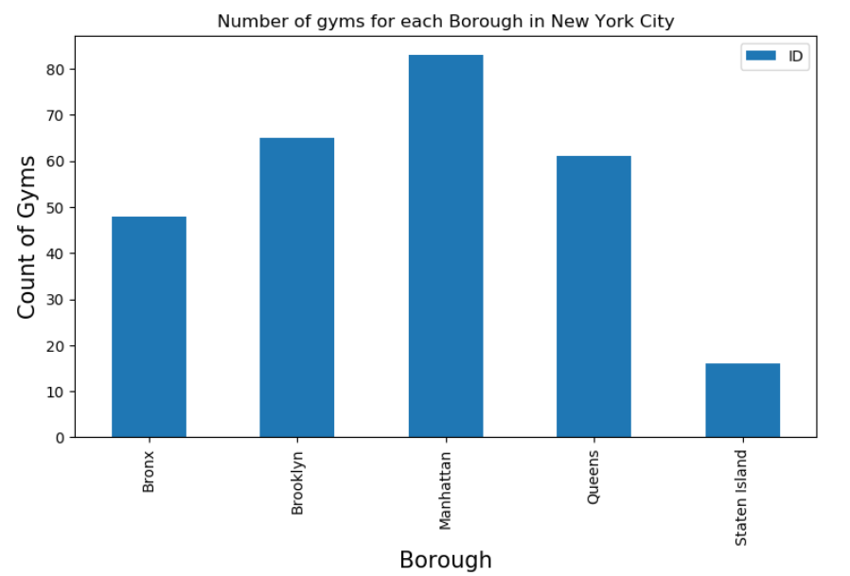
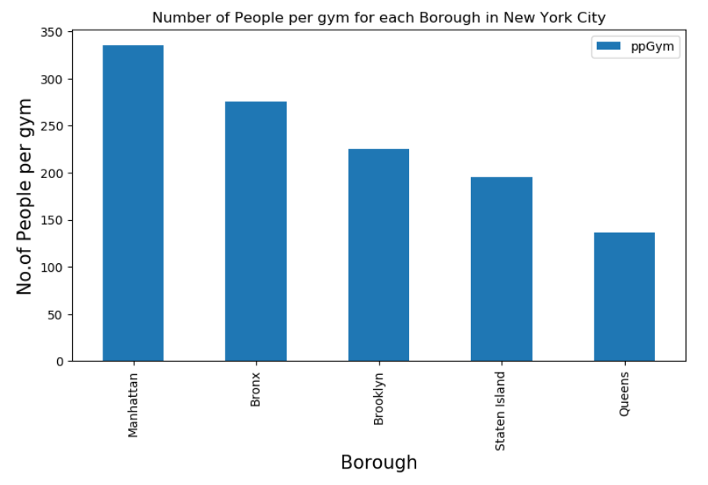
Key findings:
Manhattan has the best population density per gym allowing for best chance of obtaining gym goers
Notes:
Insert a picture of an animal and or plant found in your country.

Slide 7
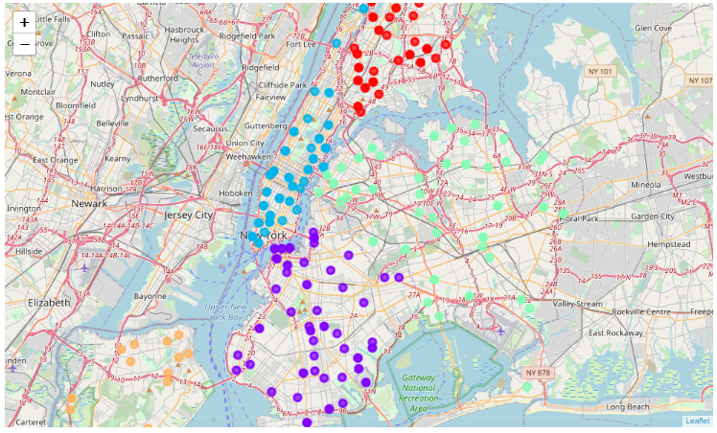
Key findings:
Manhattan density of gyms is well spread for robust analysis of gyms in the Manhattan area.
Notes:
Insert a picture of an animal and or plant found in your country.

Slide 8
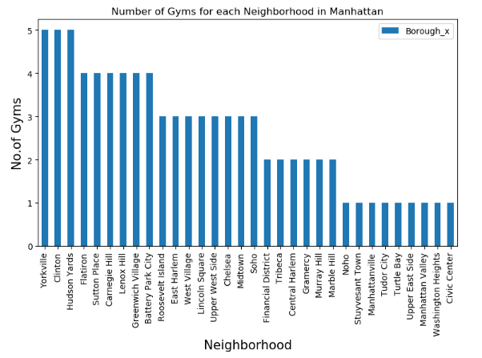
Key findings:
The best neighbourhoods for gyms to open as proof of concept is shown in Manhattan as well as spread of gyms across these neighbourhood’s allow for potential customer market steal.
Notes:
Insert a picture of an animal and or plant found in your country.

Slide 9
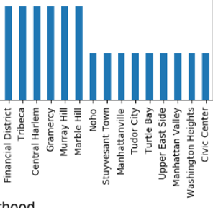
Conclusion:
Manhattan Borough has the best chance of making money when opening a gym.
Confirmed with the density of people per gym in the Manhattan area.
Gyms with the best rating are well spread and determination of the neighbourhood could be based on the neighbourhood gym count.
Any neighbourhood with gyms less than 3 can be opportunity to open a gym.
Other criteria to take into account:
Costs of location and logistics in these areas.
Notes:
Add key points in the history of your country to the timeline.

